Slide 1

Color
CAP 5738 Data Visualization
Spring 2018
Dr. Sayeed S. Alam

Slide 2
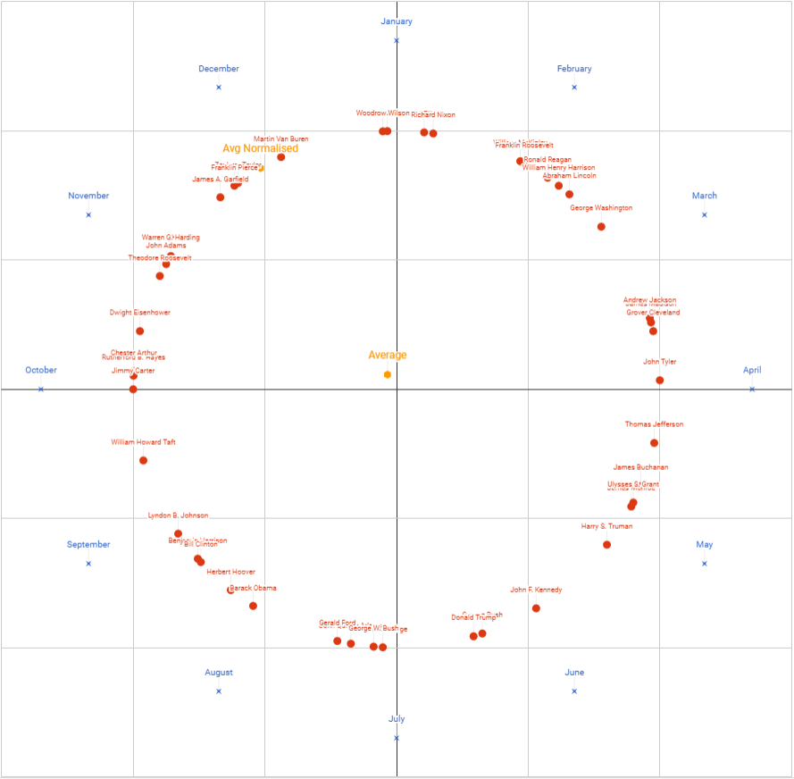
Today’s Visualization
The Average US President's Birthday is November 30th
Source: https://imgur.com/pS997qF

Slide 3
Color
Color vision does have a critical function, which is hardly surprising because this sophisticated ability must surely provide some evolutionary advantage
Color helps us break camouflage.
Some things differ visually from their surroundings only by their color

Slide 4
Pick up cherries

Slide 5
Color
Color also tells us much that is useful about the material properties of objects.
This is crucial in judging the condition of our food.
Is this fruit ripe or not?
Is this meat fresh or putrid?
What kind of mushroom is this?
It is also useful if we are making tools.
What kind of stone is this?

Slide 6
Hunter-Gatherers
In modern hunter–gatherer societies, men are the hunters and women are the gatherers.
This may have been true for long periods of human evolution, which could explain why it is mostly men who are color blind.
If they had been gatherers, they would have been more than likely to bring home poison berries—a selective disadvantage.

Slide 7
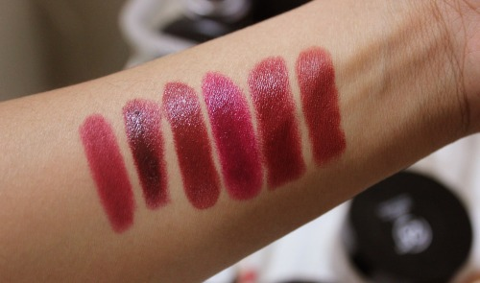
Lipstick shades

Slide 8
Trichromacy Theory
The most important fact about color vision is that we have three distinct color receptors, called cones
In our retinas that are active at normal light levels—hence trichromacy.
We also have rods, sensitive at low light levels, but they are so overstimulated in all but the dimmest light that their influence on color perception can be ignored.
Thus, in order to understand color vision, we need only consider the cones.
The fact that there are only three receptors is the reason for the basic three-dimensionality of human color vision.

Slide 9
Trichromacy Theory
The term color space means an arrangement of colors in a three-dimensional space.
Complex transformations are sometimes required to convert from one color space to another, but they are all three-dimensional, and this three-dimensionality derives ultimately from the three cone types.
This is the reason that there are three differently colored phosphors in a television tube—red, green, and blue.
Some birds, such as chickens, have as many as 12 different kinds
of color-sensitive cells. A television set for chickens would require 12 electron beams and 12 differently colored phosphors!
Because only three different receptor types are involved in color vision, it is possible to match a particular patch of colored light with a mixture of just three colored lights, usually called primaries.

Slide 10
Cone Sensitivity

Slide 11
Color Blindness
About 10% of the male population and about 1% of the female population have some form of color vision deficiency.
The most common deficiencies are explained by lack of either the long-wavelength-sensitive cones (protanopia) or the medium-wavelength-sensitive cones (deuteranopia).
One way to describe color vision deficiency is by pointing out that the three-dimensional color space of normal color vision collapses to a two-dimensional space

Slide 12
Color Blindness

Slide 13
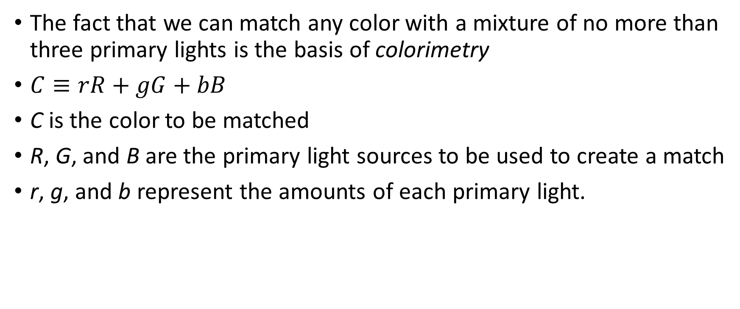
Color Measurement
The fact that we can match any color with a mixture of no more than three primary lights is the basis of colorimetry
$C≡rR+gG+bB$
C is the color to be matched
R, G, and B are the primary light sources to be used to create a match
r, g, and b represent the amounts of each primary light.

Slide 14
Color Measurement

Slide 15
CIE Colorimerty
Commission internationale de l’éclairage (CIE) is a 100 year old organization that creates international standards related to light and color.
CIE 1931 is a Color Matching System. Color matching does not attempt to describe how colors appear to humans, color matching tells us how to numerically specify a measured color, and then later accurately reproduce that measured color (e.g. in print or digital displays).

Slide 16
Trichromatic Theory
A principal quality of light is its wavelength. Humans can perceive light with waves as small as ~380nm and as large as ~750nm.
The sun emits light across many wavelengths and objects around us reflect some wavelengths and absorb some wavelengths. Below is the spectral distribution of a spinach leaf illuminated by sunlight. The leaf absorbs most wavelengths as heat, but reflects visible light around 550nm. We see this particular reflected spectral composition as green.

Slide 17
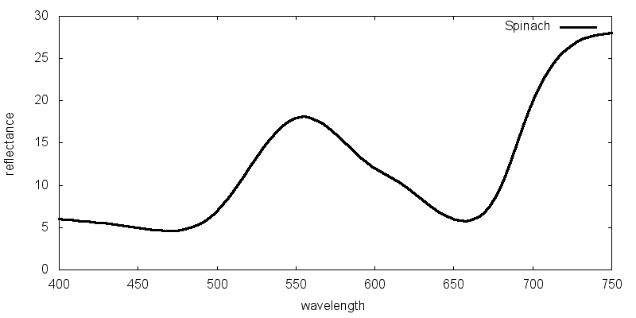
Trichromatic Theory

Slide 18
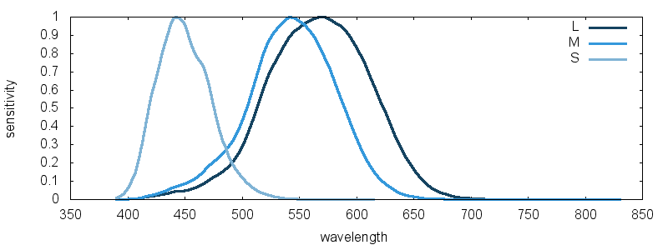
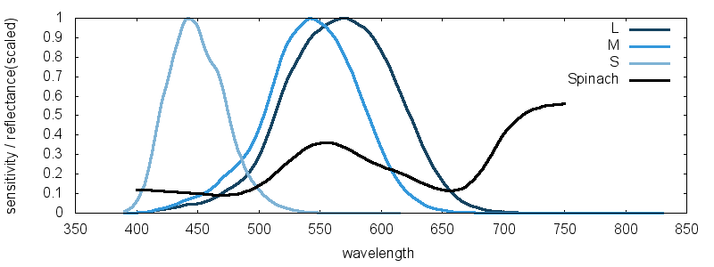
Trichromatic Theory

Slide 19
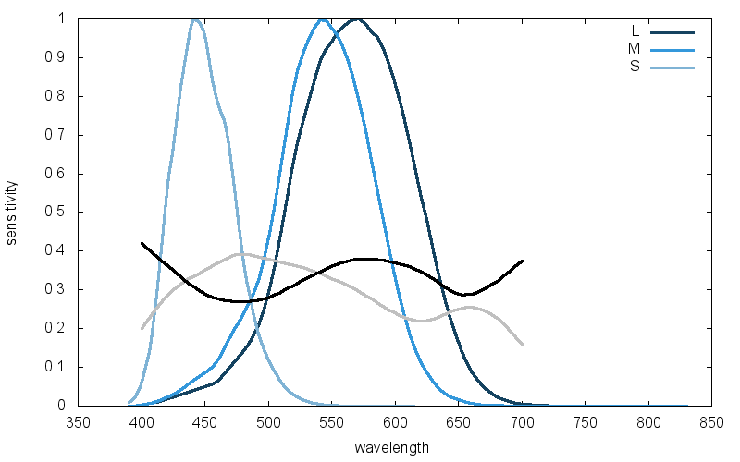
Metemerism
A leaf and a green car that look the same to you, but physically have different reflectance properties. It turns out every color (or, unique cone output) can be created from many different spectral distributions. Color science started to make a lot more sense when I finally understood this.
This phenomenon is called metemerism

Slide 20
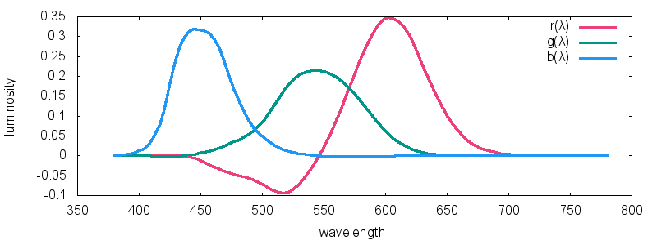
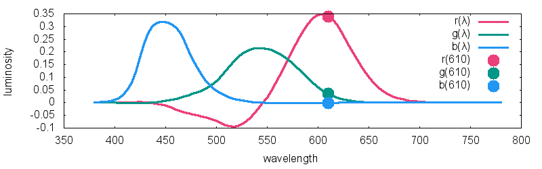
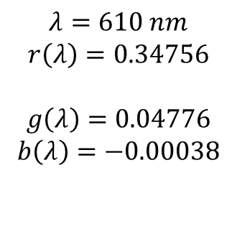
1931 CIE RGB Color Matching
$$λ=610 nm$$
$$r\left(λ\right)=0.34756$$
$$g\left(λ\right)=0.04776$$
$$b\left(λ\right)=−0.00038$$

Slide 21
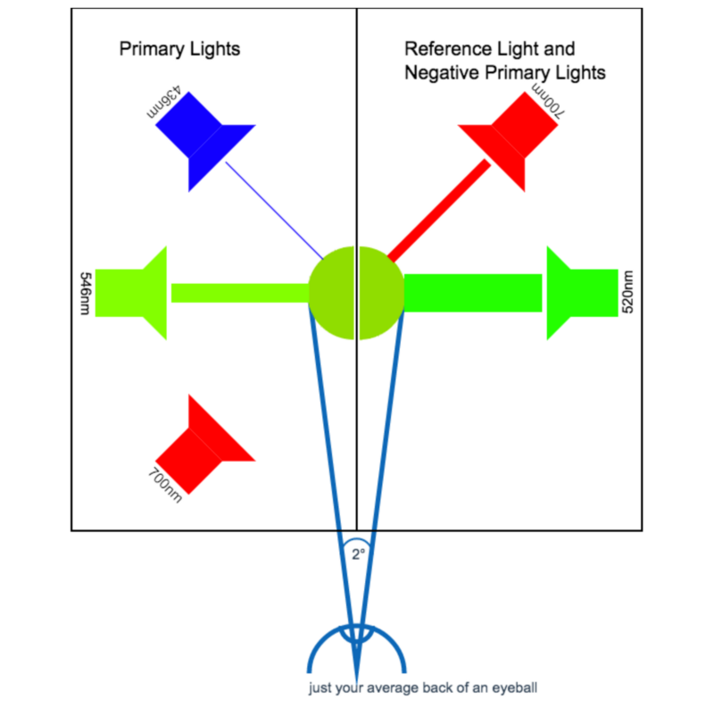
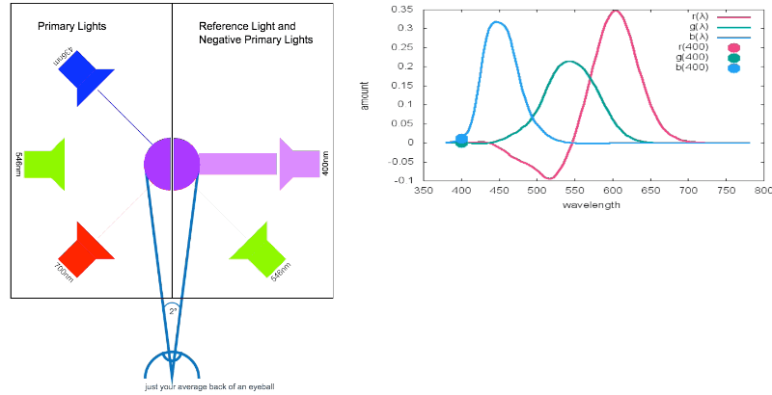
Negative Light Reference

Slide 22
CIE XYZ
The CIE system uses a set of abstract primaries called tristimulus values; these are labeled XYZ.
These primaries are chosen for their mathematical properties, not because they match any set of actual lights.
One important feature of the system is that the Y tristimulus value is the same as luminance.

Slide 23
CIE XYZ

Slide 24
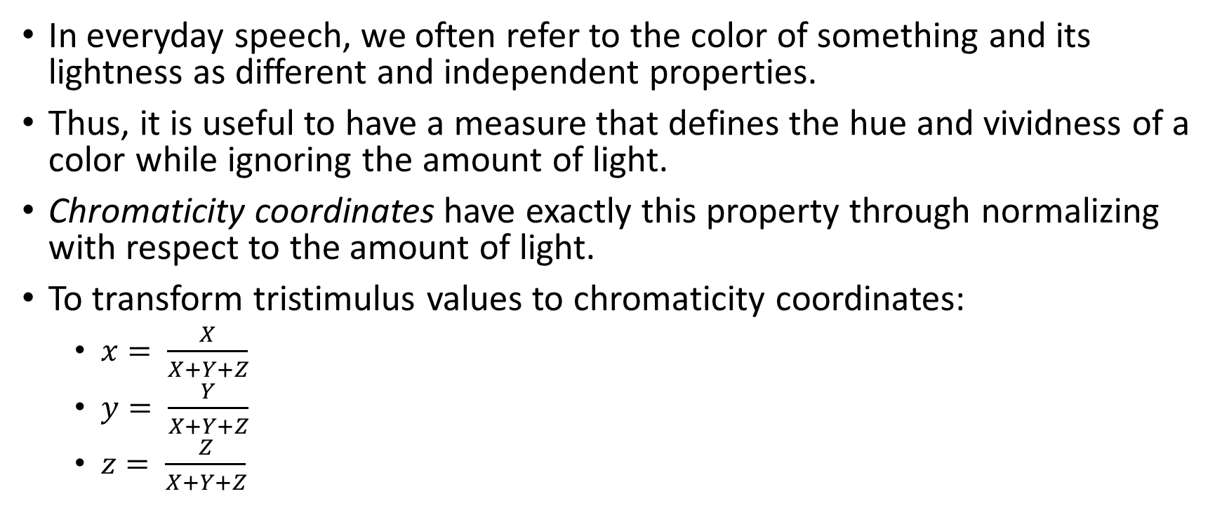
CIE XYZ Chromaticity
In everyday speech, we often refer to the color of something and its lightness as different and independent properties.
Thus, it is useful to have a measure that defines the hue and vividness of a color while ignoring the amount of light.
Chromaticity coordinates have exactly this property through normalizing with respect to the amount of light.
To transform tristimulus values to chromaticity coordinates:
$x= \frac{X}{X+Y+Z}$
$y= \frac{Y}{X+Y+Z}$
$z= \frac{Z}{X+Y+Z}$

Slide 25
CIE xyY Chromaticity
X = Yx/y
Y = Y
Z = (1-x-y) Y/y

Slide 26
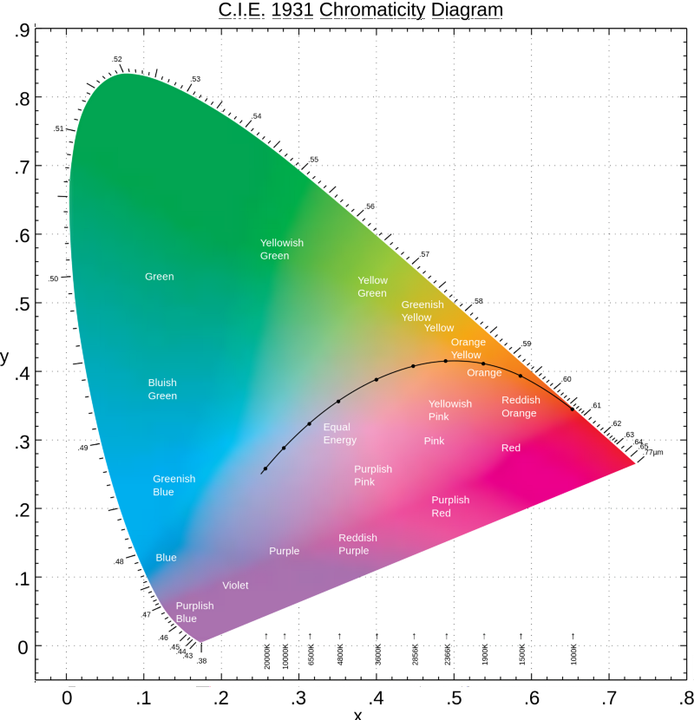
CIE xy Chromaticity Diagram
Properties:
If two colored lights are represented by two points in a chromaticity diagram, the color of a mixture of those two lights will always lie on a straight line between those two points.
Any set of three lights specifies a triangle in the chromaticity diagram. Its corners are given by the chromaticity coordinates of the three lights. Any color within that triangle can be created with a suitable mixture of the three lights.
The spectrum locus is the set of chromaticity coordinates of pure monochromatic (singlewavelength) lights. All realizable colors fall within the spectrum locus.
The purple boundary is the straight line connecting the chromaticity coordinates of the longest visible wavelength of red light, about 700 nm, to the chromaticity coordinates of the shortest visible wavelength of blue, about 400nm

Slide 27
CIE xyY Properties
The chromaticity coordinates of equal-energy white (light having an equal mixture of all wavelengths) are 0.333, 0.333. But when a white light is specified for some application, what is generally required is one of the CIE standard illuminants. The CIE specifies a number that corresponds to different phases of daylight; of these, the most commonly used is D65 (X,Y,Z = 0.9505, 1.0000, 1.0890).
Excitation purity is a measure of the distance along a line between a particular pure spectral wavelength and the white point. Specifically, it is the value given by dividing the distance between the sample and the white point by the distance between the white point and the spectrum line (or purple boundary). This measure defines the vividness of a color.
The complementary wavelength of a color is produced by drawing a line between that color and white and extrapolating to the opposite spectrum locus. Adding a color and its complementary color produces white.

Slide 28
sRGB
A Standard Default Color Space for the Internet - sRGB
Proposed by HP and Microsoft
Chromaticity | Red | Green | Blue | White point
x | 0.64 | 0.3 | 0.15 | 0.3127
y | 0.33 | 0.6 | 0.06 | 0.329
Y | 0.2126 | 0.7152 | 0.0722 | 1

Slide 29
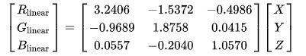
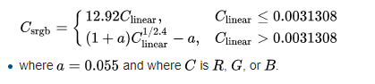
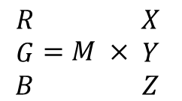
XYZ to RGB conversion
3.2406 | -1.5372 | -0.4986
-0.9689 | 1.8758 | 0.0415
0.0557 | -0.204 | 1.057
$$\begin{matrix}R \\ G \\ B\end{matrix}=M × \begin{matrix}X \\ Y \\ Z\end{matrix}$$
M =

Slide 30
Uniform Color Spaces
The CIE XYZ color space is very far from being perceptually uniform.
However, in 1978 the CIE produced a set of recommendations on the use of two uniform color spaces that are transformations of the XYZ color space.
These are called the
CIElab
CIEluv

Slide 31
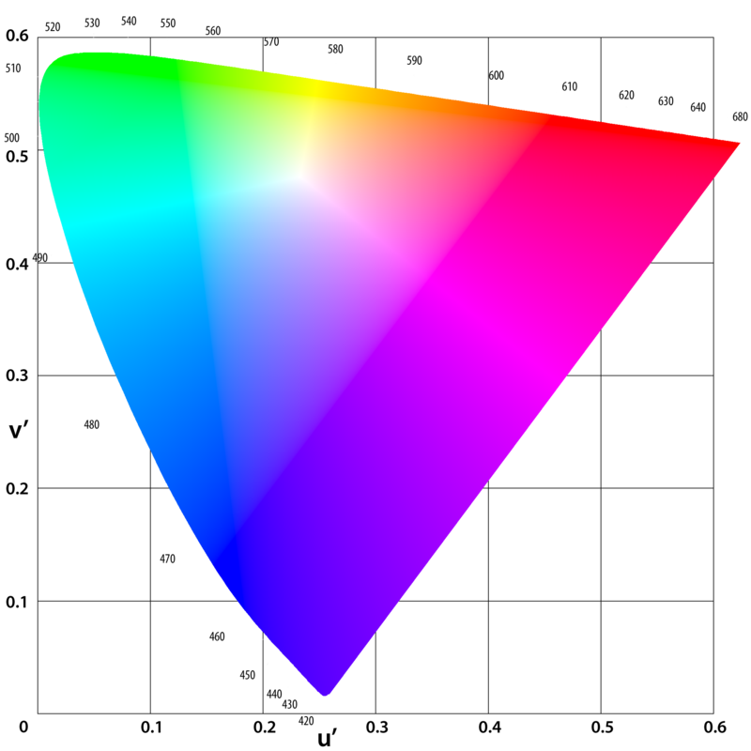
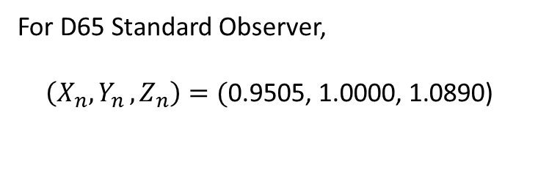
CIEluv equations
For D65 Standard Observer,
$$\left(X_{n}, Y_{n }, Z_{n}\right)=(\text{0.9505, 1.0000, 1.0890}\text{) }$$

Slide 32
Opponent Process Theory
Late in the nineteenth century, German psychologist Ewald Hering proposed the theory that there are six elementary colors and that these colors are arranged perceptually as opponent pairs along
three axes: black–white, red–green, and yellow–blue

Slide 33

Color Naming
Yellow
What color is this?
Green

Slide 34
Color Naming
How do these color look like:
Blackish-white
Reddish-green
Yellowish-Blue
They do not exist! (Opponent Colors)

Slide 35
Properties of Color Channels
From the perspective of data visualization, the different properties of the color channels have profound implications for the use of color.
The most significant differences are between the two chromatic channels and the luminance channel, although the two color channels also differ from each other.
To display data on the luminance channel alone is easy; it is stimulated by patterns that vary only from black to white through shades of gray.
But with careful calibration (which must be customized to individual subjects), patterns can be constructed that vary only for the red–green or the yellow–blue channel.
A key quality of such a pattern is that its component colors must not differ in luminance.
This is called an isoluminant or equiluminous pattern.
In this way, the different properties of the color channels can be explored and compared with the luminance channel capacity.

Slide 36
Spatial Sensitivity
The red–green and yellow–blue chromatic channels are each only capable of carrying about one-third the amount of detail carried by the black–white channel.
Because of this, purely chromatic differences are not suitable for displaying any kind of fine detail.
This is a text.
This is a text.
This is a text.
This is a text.
This is a text.
This is a text.

Slide 37
Stereoscopic Depth
It appears to be impossible, or at least very difficult, to see stereoscopic depth in stereo pairs that differ only in terms of the color channels.
Thus, stereo space perception is based primarily on information from the luminance channel.

Slide 38
Motion Sensitivity
If a pattern is created that is equiluminous with its background and contains only chromatic differences, and that pattern is set in motion, something strange occurs.
The moving pattern appears to move much more slowly than a black-against-white pattern moving at the same speed.
Thus, motion perception appears to be primarily based on information from the luminance channel.

Slide 39
Motion Sensitivity
Moving Text
Moving Text

Slide 40
Form
We are very good at perceiving the shapes of surfaces based on their shading.
However, when the shading is transformed from a luminance gradient into a purely chromatic gradient, the impression of surface shape is much reduced.
Perception of shape and form appears to be processed mainly through the luminance channel.

Slide 41
Color Contrast
Chromatic contrast also occurs in a way that is similar to the lightness contrast effects
It has been shown that contrast effects can distort readings from color-coded maps.

Slide 42
Saturation
When describing color appearance in everyday language, people use many terms in rather imprecise ways.
People use adjectives such as vivid, bright, and intense to describe colors that seem especially pure.
Because these terms are used so variably, scientists use the technical term saturation to denote how pure colors seem to the viewer.
A high-saturation color is vivid and a lowsaturation color is close to black, white, or gray.

Slide 43
Brown
Brown is one of the most mysterious colors.
Brown is dark yellow.

Slide 44
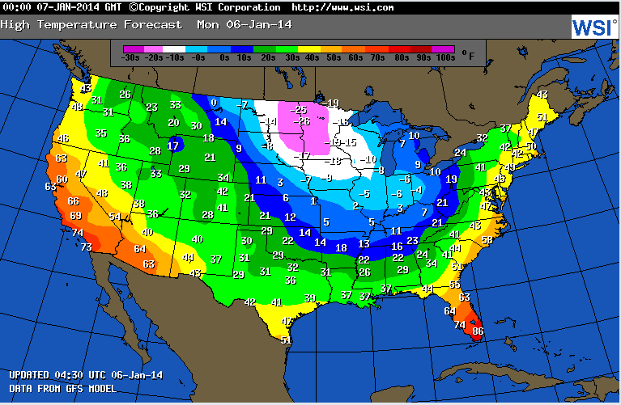
Color Applications: Heatmap

Slide 45
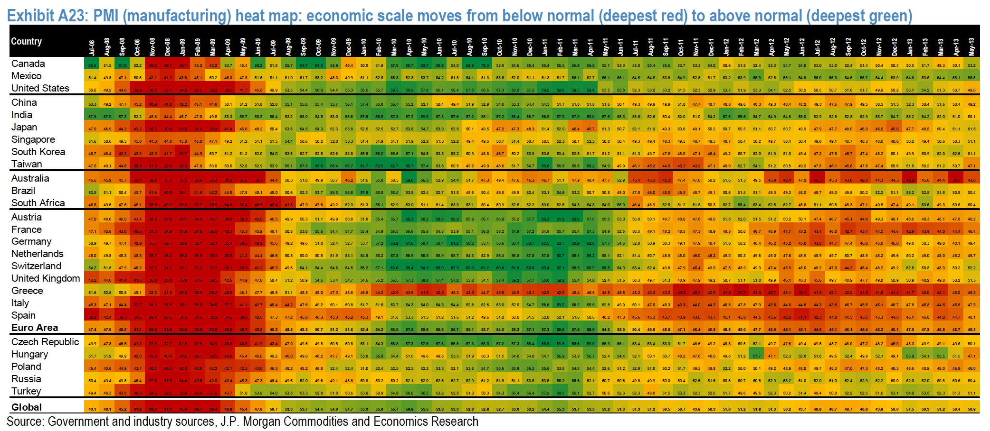
Heatmap

Slide 46
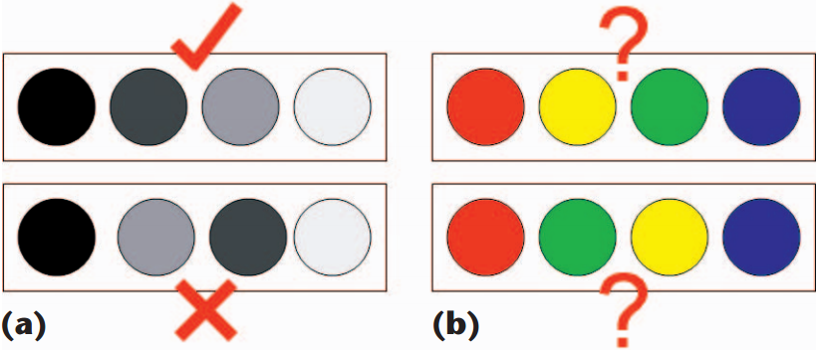
Problems with Rainbow Coloring
No perceptual ordering
Not much detail is possible
Alternatives:
Grayscale / Blackbody radiation
Sources:
http://colorbrewer2.org/#type=sequential&scheme=BuGn&n=3
Colorgorical (Offline)

Slide 47
References
https://medium.com/hipster-color-science/a-beginners-guide-to-colorimetry-401f1830b65a
https://www.w3.org/Graphics/Color/sRGB
http://www.visualexpert.com/FAQ/Part1/cfaqPart1.html
https://eagereyes.org/basics/rainbow-color-map

Slide 48
Thank You

